Slide 1
Mock the Wire, with WireMock.NET
Simplifying API Testing in .NET

Slide 2

Who am I?
Dotnet professional
(Team and technical) Lead
Full stack dev (whatever it means nowadays)
Azure dev
Hobbies:
Professional
Love building teams
Like to write articles with problems that based on random discussions
Personal
Aquariums
Dogs
Visiting and seeing history during vacations

Slide 3
The problem - Context
Web API
Query a database for specific data.
Make an external HTTP call to another service to enrich the data.
Aggregate the results
Send aggregated result to another service to trigger an email notification.
Respond to the client

Slide 4
Current battlefield
Generic Mocking Service – used by everyone

Slide 5
Battlefield - Challenges
We were changing multiple external dependencies only with one.
If the shared service was down or misconfigured, our tests failed (flaky tests ☹ )
Performance
Inability to simulate edge cases
Notes:
We were changing multiple external dependencies only with one. If the shared service was down or misconfigured, our tests failed
Tests sometimes experienced latency due to the external service’s response times, leading to longer CI/CD pipelines.
The service was meant to be generic and used by multiple services, so it was pretty hard to simulate latency spikes or timeouts.

Slide 6
The scope
We wanted to test the happy flow without calling the real service
We wanted to get confidence in our code and refactor without being afraid (since the contract remained the same, we were expecting green tests)
We wanted to be able to run the tests in the CI/CD pipeline
We wanted a generic solution.
We didn’t want flaky tests
We didn’t want different (provider) service implementation only for testing purposes
Faster feedback loop
No environment dependencies
We wanted to test rate limits, timeouts and 500 from upstream also
Notes:
7. (Tests were taking a long time to run, and if multiple services were running their tests on the same time, we even got CI/CD pipelines getting timeouts)
8. (Run on prod or run on dev, should behave the same – no inconsistencies between environments)

Slide 7
Integration vs Contract Testing
Integration Testing
Focuses on the integrity of the current service (end to end interactions between components of the current system)
Tests that the integrated components work together to perform complete business workflows (test the logic)
Tests should be run in isolation (but sometimes real implementations are used)
Contract Testing
Focuses on the contract between services
Focuses on interface compatibility rather than business logic.
Tests are run in isolation.
Notes:
Contract between services = formats, response formats, headers, status codes, and behavior

Slide 8
Wiremock.NET
Can mock HTTP & GRPC
Opensource
Minimal (and easy) setup
HTTP stubbing is matchable on Path, headers, cookies and body content pattern
Can be used with any .NET testing framework
Runs as a standalone process, as windows service, or in docker
Configurable via fluent .NET, JSON files
Supports record and playback of stubs
[…and much more.]

Slide 9
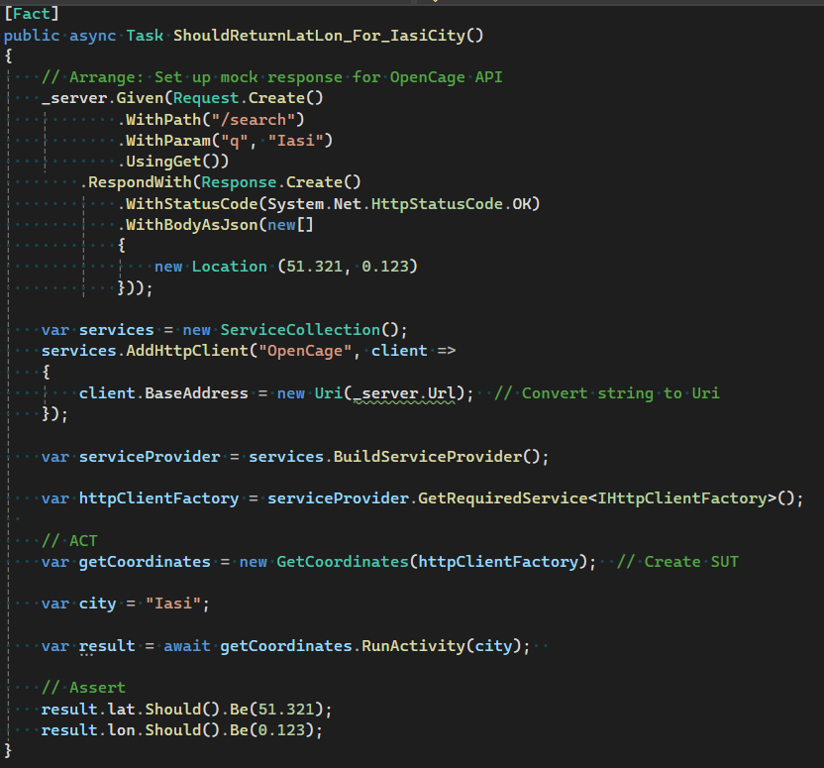
Show me some code!

Slide 10
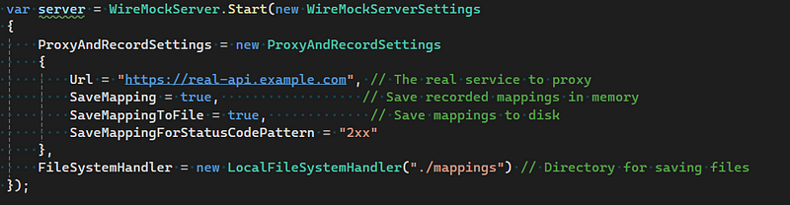
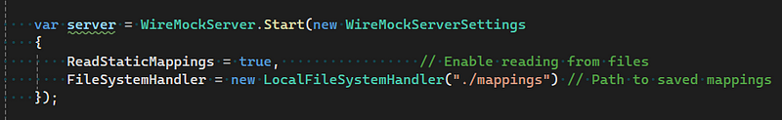
Cool feature – record and playback traffic

Slide 11
Alternatives
Postman Mock Servers
Limited flexibility
Hard to use in automation
Pact
Nice to use with the clients (since you have brokers)
It was a little bit too much “power” for me.
Notes:
Pact broker - You could create a contract between the client and my service so that both could have been developed in parallel

Slide 12
Lessons learned
Start simple and then add complexity if needed
Verify expected calls (FindLogEntries vs LogEntries)
If you’re not sure about the state of the Wiremock server reset it ( server.Reset() )!
Learning curve was smoother then expected.
Update the mocks when contracts change.
Notes:
We jumped from the beginning in complex stubbing and we ended up in having lots of logic in the responses, logic that added unneeded complexity
We ended up in some weird cases and after a lot of debugging we realized some tests were dependent of others, which is a very bad practice. Use server.Reset! (Tests should be independent and isolated)!

Slide 13
Questions?

